Slide 1
Federal Highway Administration
Performance Based
Practical Design
September 7, 2016
Robert Mooney

Slide 2
What is PBPD?
PBPD is a decision making approach
that helps agencies better manage transportation investments
and serve system-level needs
and performance priorities
with limited resources.

Slide 3
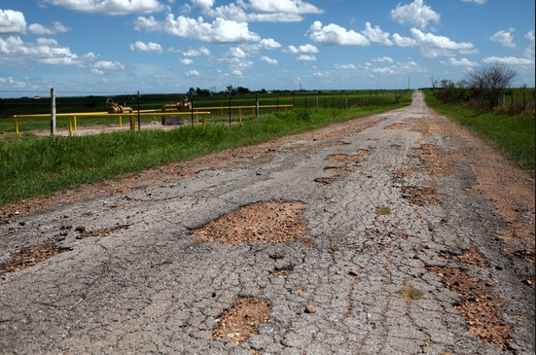
Practical Design Example

Slide 4
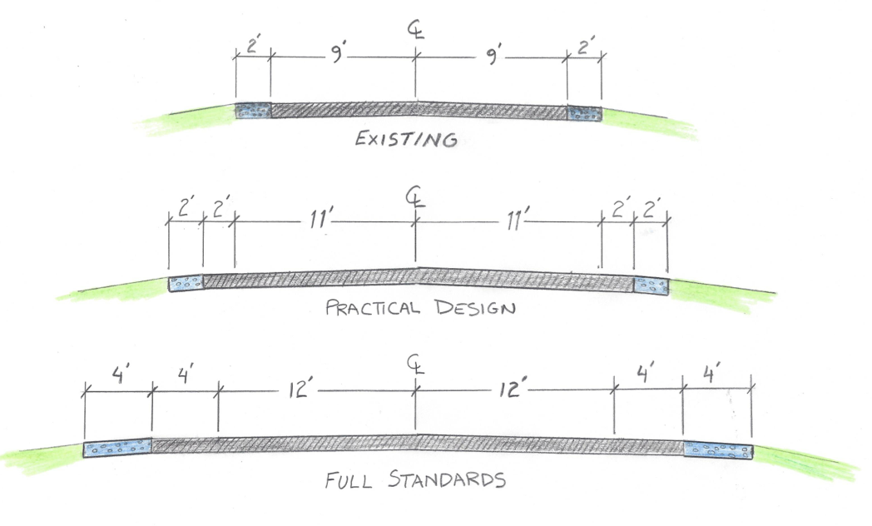
Practical Design Example

Slide 5
PBPD is not:
  New Policy, Regulation, or Requirement
  Opportunity to disregard long-term needs:
    For short term cost savings
    Overlooking future development
  Compromising on safety, user needs (bike, ped, etc.), or accommodation of freight to save money

Slide 6
Practical design, aka…
  Flexible Design
  Open Roads
  Practical Solutions
  Performance Based Practical Design
  Practical
  Engineering
  Practical Improvements
  Common Sense Engineering

Slide 7
PBPD Overviews
WA
ME
MT
ND
VT
MN
NH
OR
WI
NY
MA
ID
SD
CT
RI
WY
MI
NJ
PA
NE
IA
MD
DE
NV
IL
IN
OH
DC
UT
CO
WV
VA
CA
KS
MO
KY
NC
TN
AZ
NM
OK
AR
SC
MS
AL
GA
AK
TX
LA
FL
PR
HI
VI
18 Executive Overviews Delivered
2 Executive Overviews Planned

Slide 8
PBPD Workshops
WA
ME
MT
ND
VT
MN
NH
OR
WI
NY
MA
ID
SD
CT
RI
WY
MI
NJ
PA
NE
IA
MD
DE
NV
IL
IN
OH
DC
UT
CO
WV
VA
CA
KS
MO
KY
NC
TN
AZ
NM
OK
AR
SC
MS
AL
GA
AK
TX
LA
FL
PR
HI
VI
13 Workshops Delivered

Slide 9
Common themes of PBPD:
Project decisions are based on critical examination of geometric elements
  Select/size elements that serve priority needs
  Reduce or eliminate those that don’t
Choices made to serve project priorities while trying to save money
Project savings benefit System Needs

Slide 10
Notable attributes
PBPD focuses on performance improvements that benefit both project and system needs.
Agencies make sound decisions based upon performance analysis.
By scrutinizing each element of a project’s scope relative to value, need, and urgency, a PBPD approach seeks a greater return on infrastructure investments.

Slide 11

PBPD – Overlapping
PBPD
Asset
Mgmt.
Context Sensitive Solutions
Value
Engineering
PBPD
Asset Mgmt.
Context Sensitive Solutions
Value
Engineering
System Performance

Slide 12
Practical Design Savings
Item | Original Cost | Practical Cost | Savings
Pavement Design
Reduce driving lane from 12' to 11' | $3,600,000 | $3,300,000 | $300,000
Minimize Underdrain Depth and locations | $120,000 | $60,000 | $60,000
Shoulder Design
Reducing shoulder Aggregate width 4' to 1' | $160,000 | $40,000 | $120,000
Reduce to 3:1 Side Slopes and V-bottom ditches | $775,000 | $525,000 | $250,000
Utilities
Relocate 8" gas line to lower elevation | $3,000,000 | $500,000 | $2,500,000
Move OH utilities inside Clear Zone:
Reduce trees to be removed | $232,000 | $132,000 | $100,000
Reduce area of mitigated wetlands | $500,000 | $400,000 | $100,000
Reduce number of mitigated trees | $50,000 | $10,000 | $40,000
Structures
Modify instead of replace most large structures | $700,000 | $200,000 | $500,000
Structure Removal | $120,000 | $20,000 | $100,000
Minimizing Cover Depth at Crest Curves |  |  | $40,000
Structure Backfill | $60,000 | $20,000 | $40,000
TOTAL PROJECT SAVINGS: | $4,150,000

Slide 13
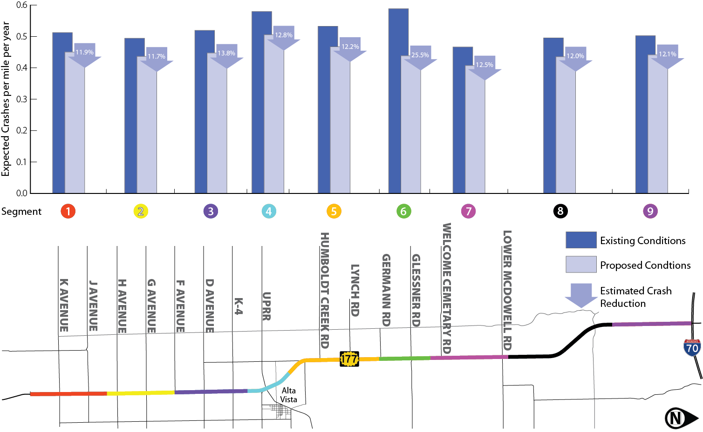
Performance Based Practical Design Example
Notes:
The presentation of the “DESIGN TO BUDGET” approach presented the benefits of investing less than the available $25Million by quantifying the benefits. Safety was shown first, as seen on this slide, and all sections of the project were predicted to reduce serious injury and fatal crashes by 10% or more. The worst section of the entire corridor was expected to reduce crashes by >25%.
Background: Case study is on the web at http://www.ihsdm.org/wiki/Kansas_DOT:_%22Designing_to_a_Budget_and_More:_Use_of_the_Highway_Safety_Manual_at_the_Kansas_Department_of_Transportation%22.
The Kansas Department of Transportation (KDOT) selected K-177 from Council Grove to I-70 as a modernization project with a set construction budget of $25 million (FY 2017), but construction costs to completely reconstruct this 22.9-mile corridor were estimated to be $67 million. As a result, KDOT conducted extensive modeling of current and projected operations and safety, which allowed them to select a project scope that achieves the performance objectives of a modernization project within the given budget constraints. The selected scope is projected to operate at a Level of Service B for its design life, increase passing opportunities on the project corridor by 14 percent, and result in a projected 13 percent decrease in the expected number of crashes compared to no-build conditions. In addition to engineering analysis, KDOT assembled a representative group of stakeholders from local communities to provide feedback regarding the selection of proposed improvements. Project construction letting is scheduled for March 2017.
Utilizing the Highway Capacity Manual and TWOPAS, KDOT determined that traffic operations did not need to be a major concern and that the development of design concepts should focus on safety improvement needs.

Slide 14
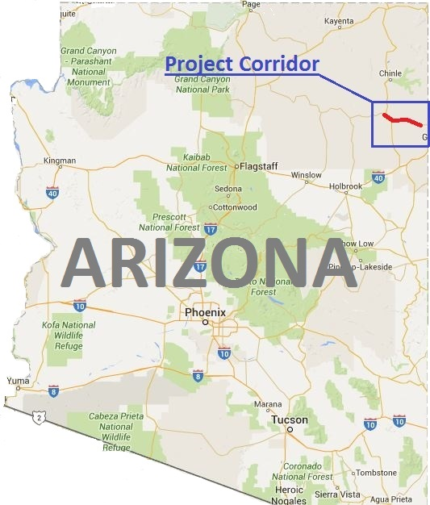
Performance Based Practical Design Example
Notes:
Overview
The Arizona DOT (ADOT) recognized that a significant portion of fatal crashes were roadway departures along rural two-lane highways. They took a systemic approach to review these highways with a high risk for run-off-roadway crashes. Based on that review, ADOT identified State Route 264 (SR 264), a 25-mile corridor from Burnside Junction to Summit One as a priority corridor for shoulder widening and slope flattening as a project to address the high crash rate.
Utilizing a Performance Based Practical Design approach to maximize the return on investment while recognizing the needs of the overall transportation system, ADOT developed and evaluated possible solutions that would improve the safety and operational performance of the corridor over the no-build condition while recognizing the need to address and accommodate non-motorized vehicles. The ADOT:
Developed and evaluated two alternatives
Alternative A: Widen existing roadway to 34 feet; 12 foot lanes, 5 foot shoulders, add centerline and shoulder rumble strips, flatten side slopes, install guardrail, etc. The 5 foot shoulder incorporates a 4 foot bikeable width outside of the rumble strip.
Alternative B: Widen existing roadway to 40 feet; 12 foot lanes, 8 foot shoulders, add centerline and shoulder rumble strips, flatten side slopes, install guardrail, etc.
Performed safety analysis using Highway Safety Manual predictive method procedures and the Interactive Highway Safety Design Model
Performed a benefit-cost ratio analysis to assist selecting an alternative
Results
By using PBPD, ADOT was able to quantify the safety and operational deficiencies of the corridor, target safety and operational improvements while incorporating and accommodating bicyclists in the final design
ADOT selected Alternative A with the lower overall cost and higher benefit-cost ratio
Savings realized by using the PBPD approach can now be used on other similar highway corridor projects

Slide 15
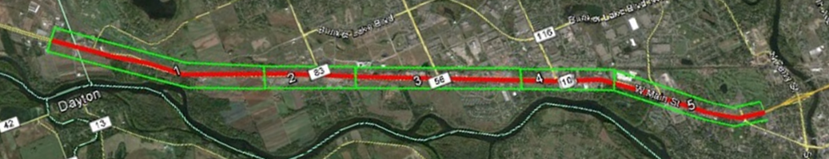
Performance Based Practical Design Example
Highway 10 | 2013 AADT (vehicles per day)
1. Ramsey West | 33,500
2. Armstrong Boulevard | 33,500
3. Ramsey Boulevard | 38,500-44,000
4. Sunfish Lake Boulevard | 44,000-47,500
5. Anoka | 47,500-60,000
Severity | Number | Percent
Fatal | 13 | 0.8%
Incapacitating Injury | 29 | 1.8%
Non-Incapacitating Injury | 135 | 8.3%
Possible Injury | 324 | 20.0%
No Injury (PDO) | 1,120 | 69.1%
Total | 1,621 | 100.0%
Notes:
Overview
This case study illustrates how a state, with limited funding, utilized components of a PBDP approach to develop alternatives to a potential solution. Through quantitate analysis, less expensive alternatives can be found that still attain the vast majority of safety and/or capacity benefits of a more expensive alternative. In this case study, a series of projects were developed that are estimated to able to attain 96% of the safety benefits and 90% of the operational benefits of a freeway at less than 50% of the cost.

Slide 16
Performance Based Practical Design Example
Groups Analyzed | Estimated # of Crashes Reduced | Percent Benefit of Freeway Alternative
1 | 136 | 19%
1-2 | 428 | 60%
1-3 | 494 | 70%
1-4 | 623 | 88%
1-5 | 663 | 94%
1-6 | 683 | 96%
Notes:
Overview
This case study illustrates how a state, with limited funding, utilized components of a PBDP approach to develop alternatives to a potential solution. Through quantitate analysis, less expensive alternatives can be found that still attain the vast majority of safety and/or capacity benefits of a more expensive alternative. In this case study, a series of projects were developed that are estimated to able to attain 96% of the safety benefits and 90% of the operational benefits of a freeway at less than 50% of the cost.
The individual projects were grouped together to simplify the analysis. The following six groups were analyzed:
Group 1 – Access Management Projects
Group 2 – Fairoak Signal Removal
Group 3 – Thurston Avenue Westbound Free Flow
Group 4 – Ramsey and Sunfish Lake Boulevard Westbound Free Flow
Group 5 – Thurston Avenue Eastbound and Westbound Free Flow
Group 6 – Sunfish Lake Boulevard Eastbound and Westbound Free Flow
Free Flow Improvement concepts:
Surface street extensions and new construction
Restricted crossing U-turn intersections
Right-of-way purchases
Roadway realignment
Revisions to left-turn treatments at T intersections
Construction of flyover ramps
Construction of overpasses and underpasses
Driveway removals
Signal removal
The safety analysis estimated that the six groups of proposed projects would provide 96 percent of the safety benefit of the freeway alternative with less than 50 percent of the cost to convert the roadway into a freeway. Figure 3 provides a graphical representation of the estimated safety benefit and cost for the proposed projects against the benefit and cost that would be obtained with the freeway alternative.
The difference in delay for the freeway alternative and the proposed projects was compared against the difference in delay between the freeway alternative and the “do nothing” case. The freeway alternative is able to reduce the delay by 537 vehicle hours in the afternoon rush. However, the 487 vehicle hour reduction of the 6 groups of proposed projects is approximately 90 percent of the operational benefit that would be observed with the construction of a freeway along Highway 10 but with a substantially lower cost. Figure 4 illustrates the operational benefit and cost associated with the proposed projects against the benefit and cost that was estimated for the freeway alternative.

Slide 17
All Engineering choices have trade-Offs
Which One Would You Choose?
Below Design Criteria
Meets or Exceeds Design Criteria
Same Cost,
Better Value
Option B
Value
(Operations, Safety, Efficiency etc.)
Minimum Standards
Same Value, Lower Cost
Option A
Cost

Slide 18
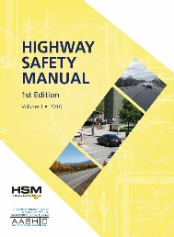
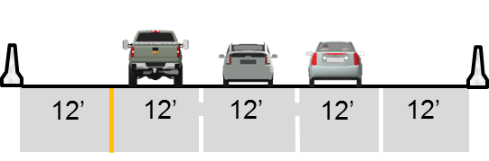

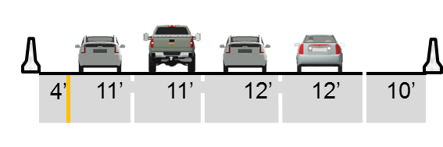

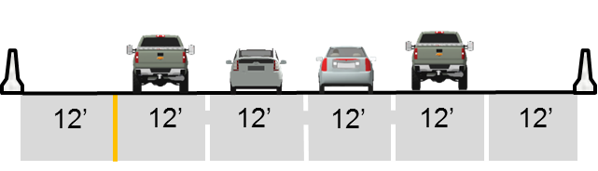

Interactive Exercise:
Expanding Freeway Capacity
Given the same traffic volume, which of these three options will the HSM predict:
1. Fewest total crashes?
2. Fewest fatalities?
No Build
Add lane by reconfiguring widths
Construct new lane(s) and shoulders

Slide 19
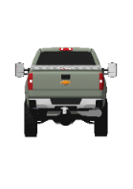






Can we have the best of both?
Can we make more out of our alternatives?
12’
12’
12’
12’
12’
4’
11’
11’
12’
12’
10’
12’
12’
12’
12’
12’
12’
12’
12’
12’
12’
12’
Notes:
K – at least one fatality occurs
A – at least one disabling injury occurs
B – at least one evident, non-disabling injury occurs
C – at least one possible injury occurs
PDO – no injury occurs but property damage in excess of the state’s minimum reporting threshold occurs

Slide 20
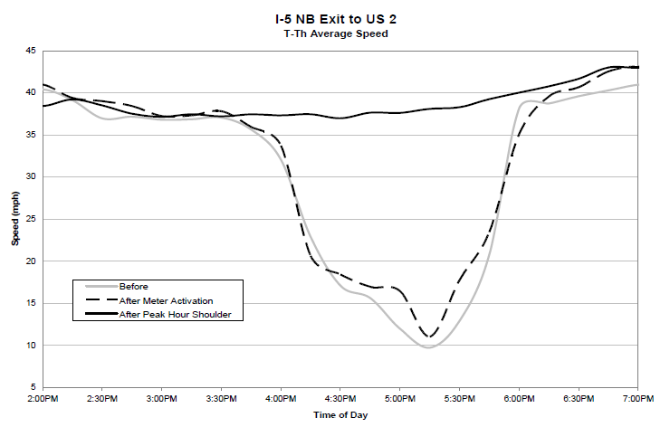
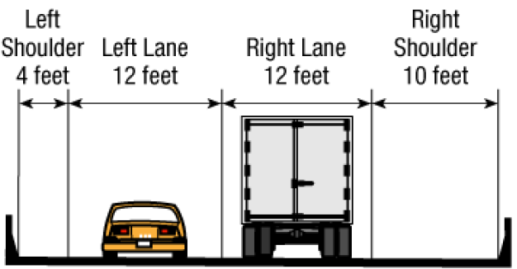
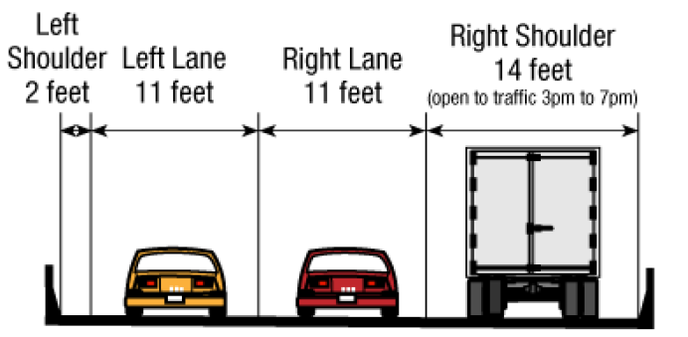
Operational Benefits of Shoulder Running
Before
After

Slide 21
Shoulder Use and Limitations of the HSM

Slide 22
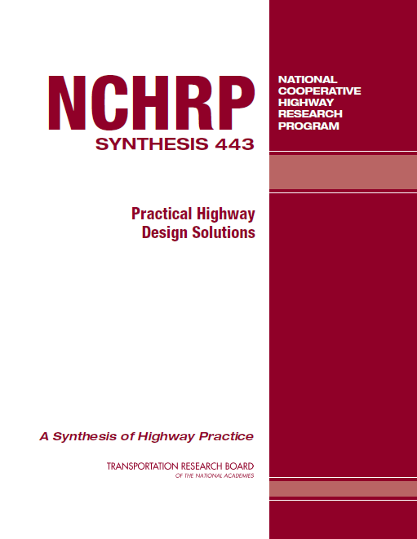
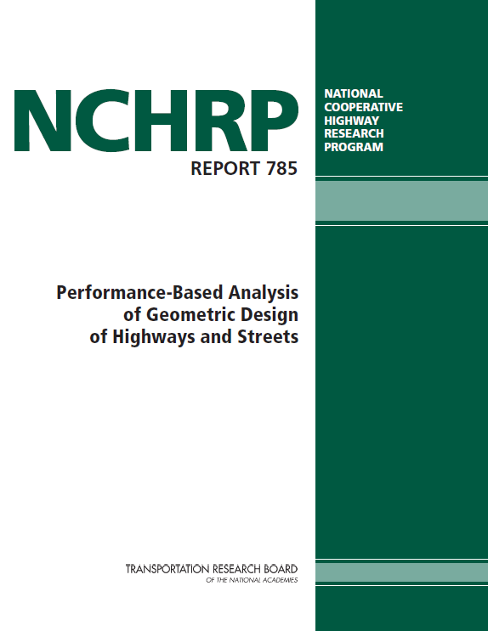
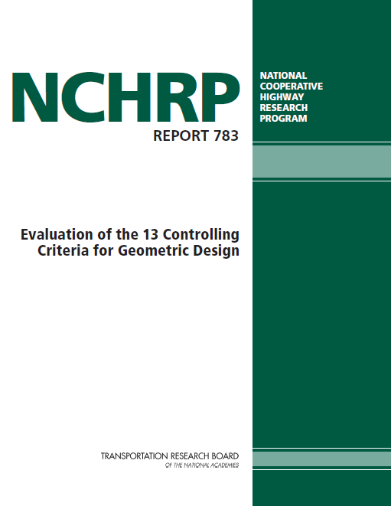
Key Reports
Notes:
These are 3 key reports that are available that can be used to further support PBPD

Slide 23
Controlling Criteria
Effective May 5, 2016 -- Controlling Criteria for NHS
Design Speed ≥ 50 mph:
  Design Speed
  Lane Width
  Shoulder Width
  Horizontal Curve Radius
  Superelevation
  Stopping Sight Distance
  Maximum Grade
  Cross Slope
  Vertical Clearance
  Design Loading Structural Capacity
Low Speed Roadways
(Design Speed < 50 mph):
1. Design Speed
2. Design Loading Structural Capacity
Notes:
New Controlling Criteria published on May 5, 2016

Slide 24
www.regulations.gov
The new policy eliminated:
  Bridge Width
  Vertical Alignment
  Lateral Offset to Obstruction
And renamed:
  Horizontal Alignment → Horizontal Curve Radius
  Grade → Maximum Grade
  Structural Capacity → Design Loading Structural Capacity

Slide 25
FHWA Will be a good partner
FHWA is prepared to support States as they develop projects with a system performance mindset
using data-driven methods

Slide 26
www.fhwa.dot.gov/design/pbpd/
Robert Mooney
202-366-2221
Robert.Mooney@dot.gov
George Merritt
404-562-3911 george.merritt@dot.gov

